Slide 1
Women On Web Case

Slide 2
Background
Dec 13, 2020, KCSC issued a ruling to block access to WoW in Korea
No appeal/judicial review
We have been denied at the first step
Two choices now: appeal or submit claim to constitutional court

Slide 3
IJC Brief
We are preparing a draft that will work for either scenario
Centered around the ICCPR, which was ratified by the Republic of Korea on April 10, 1990

Slide 4
Article 19 of the ICCPR
Article 19
2. Everyone shall have the right to freedom of expression; this right shall include freedom to seek, receive and impart information and ideas of all kinds, regardless of frontiers, either orally, in writing or in print, in the form of art, or through any other media of his choice.
3. The exercise of the rights provided for in paragraph 2 of this article carries with it special duties and responsibilities. It may therefore be subject to certain restrictions, but these shall only be such as are provided by law and are necessary:
a) For respect of the rights or reputations of others;
b) For the protection of national security or of public order (ordre public), or of public health or morals.

Slide 6
Three-Part Test
Legitimacy
Legality
Necessity/Proportionality
* Also, there is a “sufficient safeguards” argument… so four-part test

Slide 7
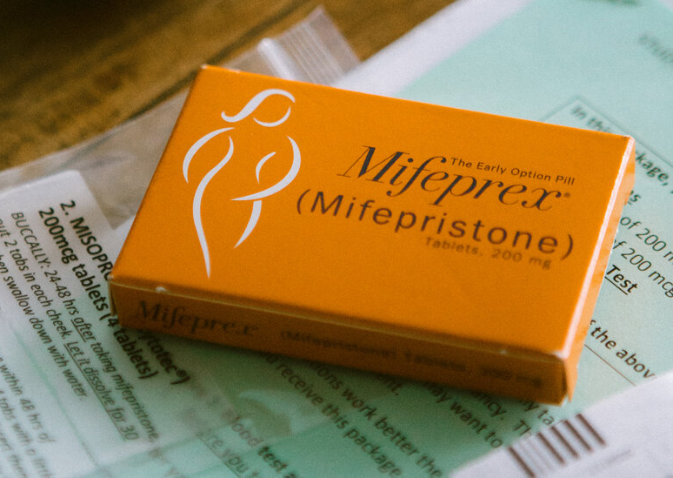
Unfortunately…
It is illegal to sell abortion pills in Korea currently
Drug is still pending approval

Slide 8
Sufficient Safeguards
Bantam Books v. Sullivan. US Supreme Court case about government administration censoring books. Provides the basic position that judicial authorization is required for website blocking.

Slide 9
Necessary/Proportional
General Comment 34, para 43, to the ICCPR gives us the conclusion that general bans on websites/content rather than specific targeted bans are incompatible with Article 19(3)

Slide 10
Support
Philippines Supreme Court has said that targeted takedown of internet data is unconstitutional
* Turkey Constitutional Court ruled that the Turkish telecommunications authority could not block or takedown within four hours
Spanish Supreme Court has said that whatever the authority to block a website, must be proportionate

Slide 11
France Constitutional Council has two relevant decisions:
HADOPI Decision (2009) – Three Strikes system blocking user access unconstitutional
Avia Law Decision (2020) – Removal of content within 24 hours if notified declared disproportionate

Slide 12
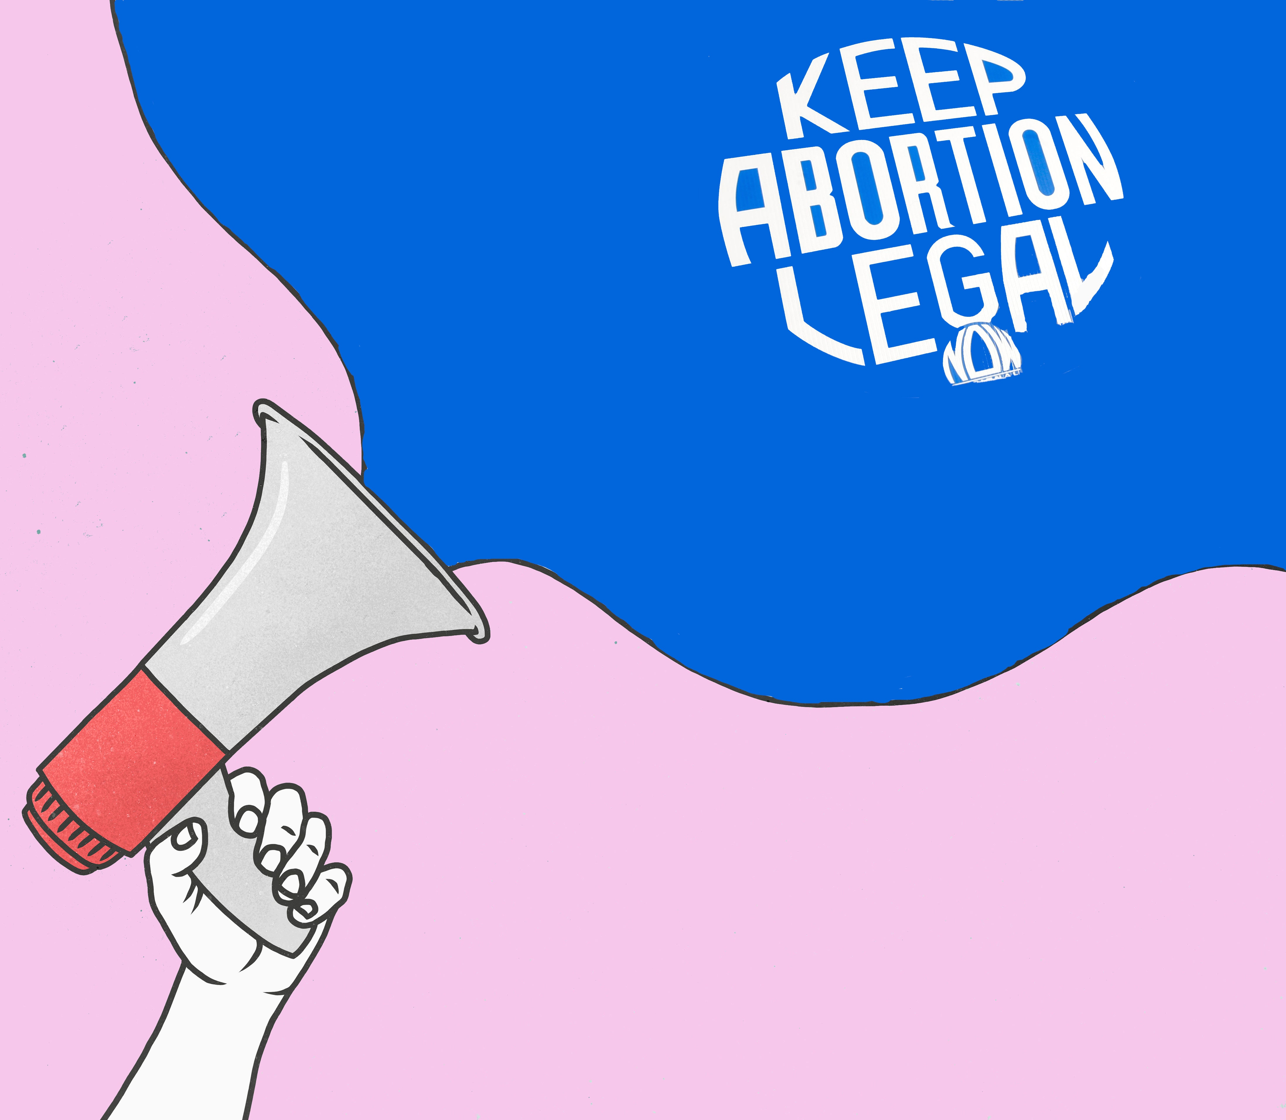
Conclusion
Our argument is that we have norms of requiring both judicial review and proportionality when blocking access to the internet

